Slide 1


Does short-selling threat discipline managers in mergers and acquisitions decisions?
JAE | 2019
Chang, Lin, and Ma

Slide 2
Do Short-sellers Impact Risky Decisions?
WSU
Research Question
“In 2011, Muddy Waters, a U.S. short-seller fund, accused Focus Media of overstating the size of its business and of deliberately overpaying for acquisitions.”
- Matos (2015)
“Analysts sometimes recognized that the short sellers were right about company weaknesses yet had to maintain good relationships with companies.”
Activist Short Sellers vs. Financial Analysts: Competitive Claims of Expertise | HEC Paris

Slide 3



Short-sellers vs Analysts
WSU
Research Question
“Short-selling threat has a governance effect on managerial M&A decisions ex ante, reducing the likelihood of making value-destroying deals and thus leading to higher acquirers’ announcement returns for the realized deals.”

Slide 4
Hypothesis Development
WSU
Research Question
Existing studies suggest that short sellers are informed an able to uncover bad news that otherwise might remain hidden, as more short-selling activities predict poor future security price performance.
Prior Literature
Grossman and Stiglitz (1980) argue that arbitrageurs have incentives to spend time and resources to gather, analyze and uncover firm-specific new information only if such activities generate corresponding trading profits
“If the equity LS of a firm is very limited, the trading profits might not be enough to compensate for the incurred costs and risks”
This scrutiny thereby leads the firms’ stock price to reflect its intrinsic value
Equity LS proxies for activity… but also opportunity?
Future Security Performance
Analyst Downgrades
Fraudulent Reporting
Mergers & Acquisitions

Slide 5
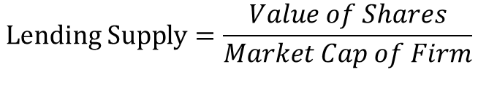
Lending Supply (LS)
WSU
Markit Data
“We define LS as the value of shares available for lending relative to a firm’s market capitalization.” (360 Day Average)
When an investor wants to short sell a stock, they must borrow shares from someone who already owns them and is willing to lend them out (institutional lenders)
The lending supply represents the number of shares that are available to be borrowed
If the lending supply for a stock is high, it suggests that there is a large pool of potential short sellers who may be interested in borrowing shares to sell short
Conversely, if the lending supply is low, it may indicate that short sellers are less likely to be active in that particular stock…
because they have the inability to be active…
$$Lending Supply=\frac{Value of Shares}{Market Cap of Firm}$$

Slide 6


Lending Supply (LS)
WSU
A Proxy
Prior studies have consistently demonstrated that, as a group, short‐sellers are sophisticated investors with superior information processing capabilities (e.g., Dechow et al. 2001; Desai et al. 2002; Drake et al. 2011; and Engelberg et al. 2012)
- In Short Supply: Short‐Sellers and Stock Returns
SETTLEMENT DATE | EXCHANGE | TOTAL CURRENT SHORT INTEREST | TOTAL PREVIOUS SHORT INTEREST (Revised) | NUMBER of SECURITIES with a SHORT POSITION | NUMBER of SECURITIES with a POSITION >= 5,000 SHARES
03/15/2023 | NYSE | 13,250,047,327 | 13,017,950,462 | 3,261 | 2,744
03/15/2023 | NYSE American | 651,156,550 | 636,470,982 | 343 | 252
03/15/2023 | NYSE Arca | 2,010,634,548 | 1,898,279,020 | 1,929 | 1,310
03/15/2023 | NYSE Group | 15,911,838,425 | 15,552,700,464 | 5,533 | 4,306
$$Short Interest Ratio=\frac{SI}{ADTV}$$
$$Hedge Fund \text{A}→ \frac{\$25M USD ∗3\%}{360}=\$2,083.33$$

Slide 7
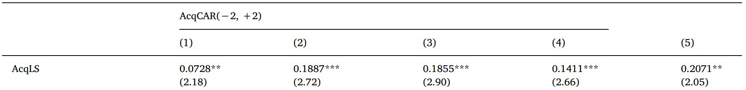
Economic Mechanisms
WSU
Results
Baseline Regression:
“These results support our hypothesis that when managers face a greater short-selling threat (increased lending supply), they are less likely to conduct value-destroying M&A.”

Slide 8
Endogeneity Concerns
WSU
Critique
Alternative Explanations – Correlations with institutional ownership? The quality of management, which is difficult to measure, may be linked to both LS and the quality of M&A decisions, as higher-quality managers attract more capital and are capable of more effectively engaging in M&A.
Instrumental Variable Estimations – To establish causality, authors show that results hold when they exploit quasi-index investor ownership (Bushee, 2001) as the first instrumental variable for LS. They also hold when using Russell index inclusion as another instrumental variable method.
Residual of Lending Supply – LS is closely related to firm characteristics, such as the concentration of institutional holdings and passive institutional ownership ratio, authors estimate the residual term of LS based on Prado et al. (2016).
PILOT Program – Regulation SHO was announced by the SEC in 2004. Under this regulation, randomly selected firms’ price restrictions on short selling (uptick rules) were lifted during the period from May 2, 2005, to August 6, 2007.

Slide 9
An Alternative?
WSU
Critique
“We find that the ex ante net lending supply of bidder shares has a positive impact on the percentage of cash in public target payments.”
Dutordoir, Strong, and Sun – JFE, 2022
Announcements of stock-financed M&As may attract short selling of bidder shares by merger arbitrageurs
Authors hypothesize that bidders with higher short-selling potential include a higher proportion of cash in payments
Cash-financed offers (insulated) tend to result in insignificant or positive bidder stock returns (Fuller et al, 2008)

Slide 10


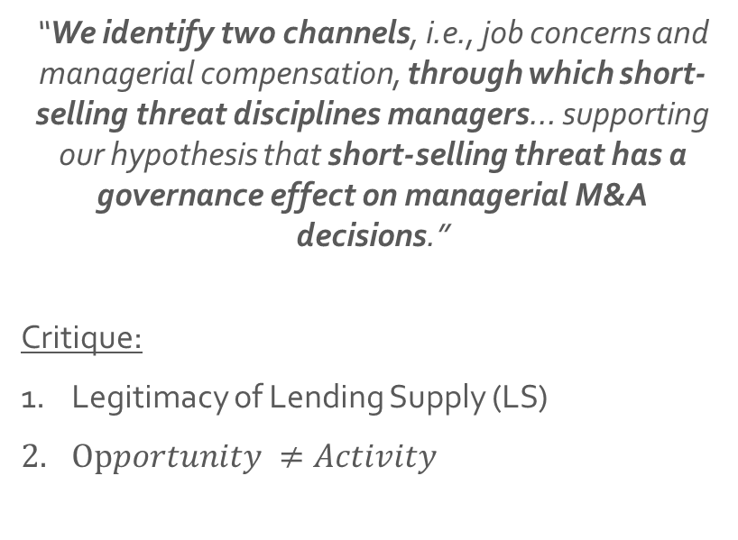

Conclusions
WSU
“We identify two channels, i.e., job concerns and managerial compensation, through which short-selling threat disciplines managers… supporting our hypothesis that short-selling threat has a governance effect on managerial M&A decisions.”
Critique:
Legitimacy of Lending Supply (LS)
$Opportunity ≠Activity$

Slide 11
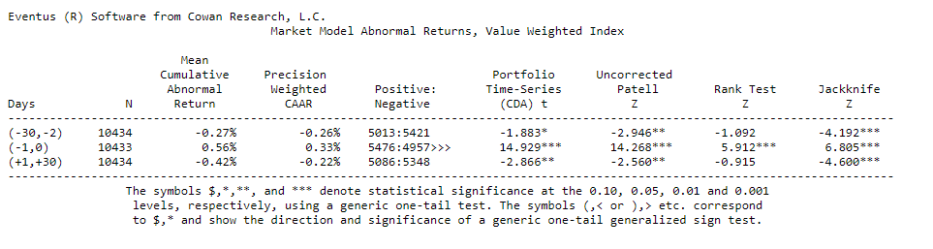
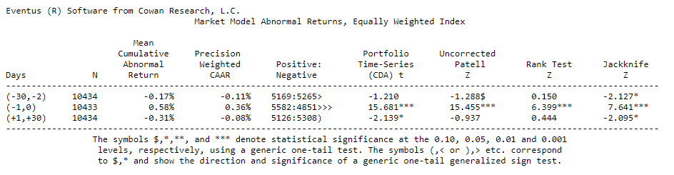
Acquirer Permno
WSU
CARs

Slide 12
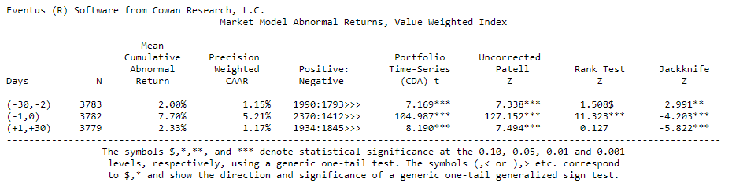
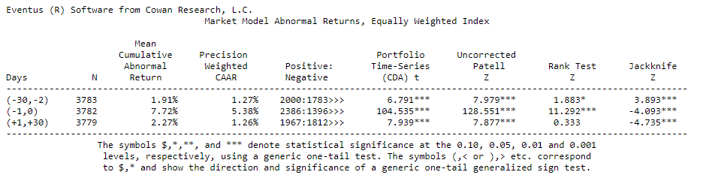
Target Permno
WSU
CARs

Slide 13

Endogeneity Concerns
WSU
CARs
“apermno”
“tpermno”

